Slide 1
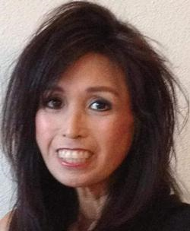
In Loving Memory Timi Tumbaga July 29, 1965 - September 22, 2015

Slide 2
Mr. Ruben Rosalez
Pittsburg High School Class of 1983
May 2, 2016
Proposal
Naming the Pittsburg Downtown Outdoor Stage in Memory of Timi Tumbaga
Proposed Stage Name: The Timi Tumbaga Community Event Stage
Pittsburg High School Class of 1983 would like to honor Timi Tumbaga by naming the downtown outdoor stage located on the corner of Railroad Avenue and East 5th Street.
Timi has been instrumental in the success of various Pittsburg community events. Because of her commitment and dedication to the City of Pittsburg, we respectfully request that the City Council Members approve our proposal to name this stage The Timi Tumbaga Community Event Stage.
An all-weather plaque will be ordered upon approval from the city council. The plaque and installation will be funded by the Pittsburg High School Class of 1983.
If approved, our committee would like to host an event to celebrate Timi’s life and to unveil the memorial plaque. Music will be provided by Gerald Glasper. We will engage speakers from the various organizations to pay tribute to Timi. The proposed date for this event is Saturday, September 24, 2016.

Slide 3
Timi Tumbaga Organizations & Events
Pittsburg High School Decade Reunions
Soroptimist International of Pittsburg
Filipino American Association of Pittsburg
Pittsburg Downtown Coordinator
Pittsburg Arts Foundation
Pittsburg Farmer’s Market
Pittsburg Holiday Parade
Pittsburg Downtown Classic Car Show
California Zinfandel Championship
Zinfandel Dinner
Kidz on Target
Pittsburg Sea Food Festival

Slide 4


Soroptimist International of Pittsburg
Filipino Association Scholarship Committee Chairperson
Pittsburg
Holiday Parade
Pittsburg
Farmer’s Market
Zinfandel Dinners
Kidz on Target
Pittsburg Downtown Classic Car Show
California Zinfandel Championship
Pittsburg
Sea Food Festival
Pittsburg
Downtown Coordinator
Pittsburg High School
Decade Reunion
Pittsburg
Arts Foundation
In Memory of
Timi A. Tumbaga
July 29, 1965 – September 22, 2015

Slide 5
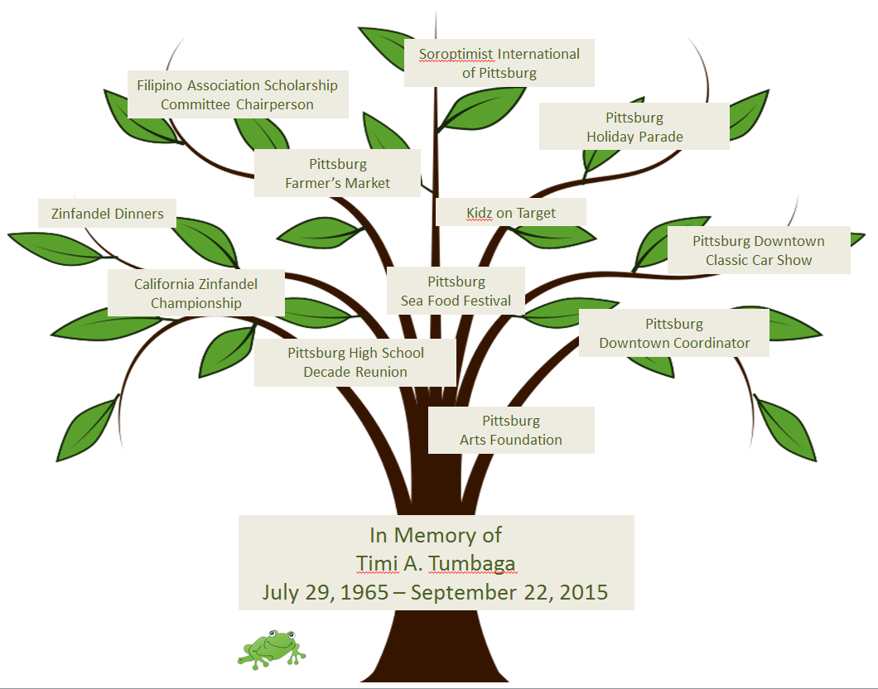
Proposed Plaque Design
Wherever a beautiful soul has been there is a trail of beautiful memories.
We miss you,
With Love from the
Class of 1983

Slide 6
Proposed Plaque Location
Proposed Plaque
Size 18” tall x 36” long
* Plaque Position: Facing the stage.

Slide 7
Stage Location: Railroad Avenue & East 5th Street

